Slide 1
Presentation Title Here

Slide 2
Tracking
Bombora + Google Analytics
LinkedIn

Slide 3
Tracking Review

Slide 4
Tag Implementation
Google Analytics script is hardcoded on website.
Traffic looks to be recording properly; no red flags observed.
GA script is altered (GDPR? Triggers when opt-out cookie is not present.)
No Google Tag Manager (GTM) container being used.
It is recommended that Google Analytics and other relevant tags are migrated into GTM for easier tag management. This reduces the need for developer involvement to implement tags.

Slide 5
Google Analytics Event/Goal Tracking
No goal tracking is enabled in GA.
This can be leveraged to track gated form submissions, such as ‘Contact Us’ requests.
Event tracking is being used to track ungated PDF downloads.
Triggering properly.

Slide 6
Bombora + Google Analytics

Slide 7
Bombora Visitor Insight Tag
The VI tag monitors traffic on every page of your website
Bombora can identify web traffic and provide demographic, firmographic and intent data attributes
This enables you to identify businesses engaging on your site, capture warm leads for your sales team even without a form fill, and accurately measure campaign performance from an account-based view
Integration with Google Analytics
Once the VI tag is placed, you can setup GA to receive information from the tag either manually via updating the GA code or through Google Tag Manager
Custom views & reports can then be created in GA, such as KPIs by demographics, AdWords keyword performance by job function, etc.

Slide 8
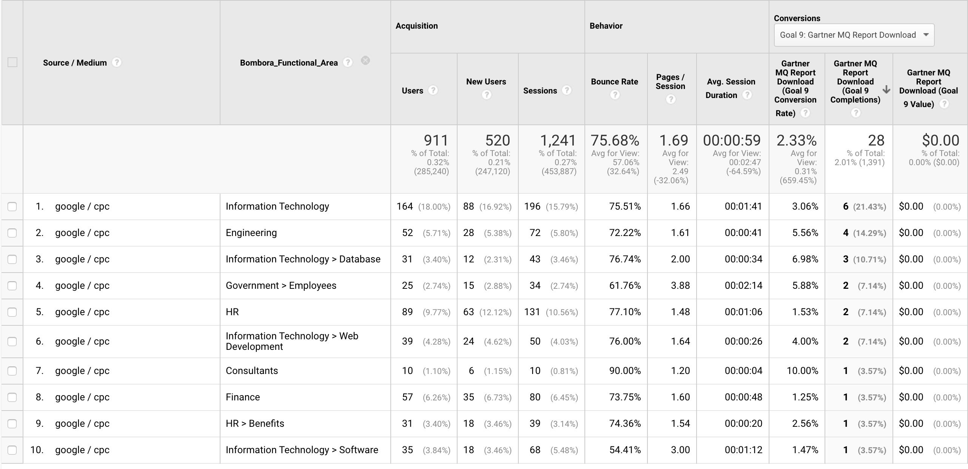
Bombora / GA Screenshots
GA view: Analyst report downloads by job function

Slide 9
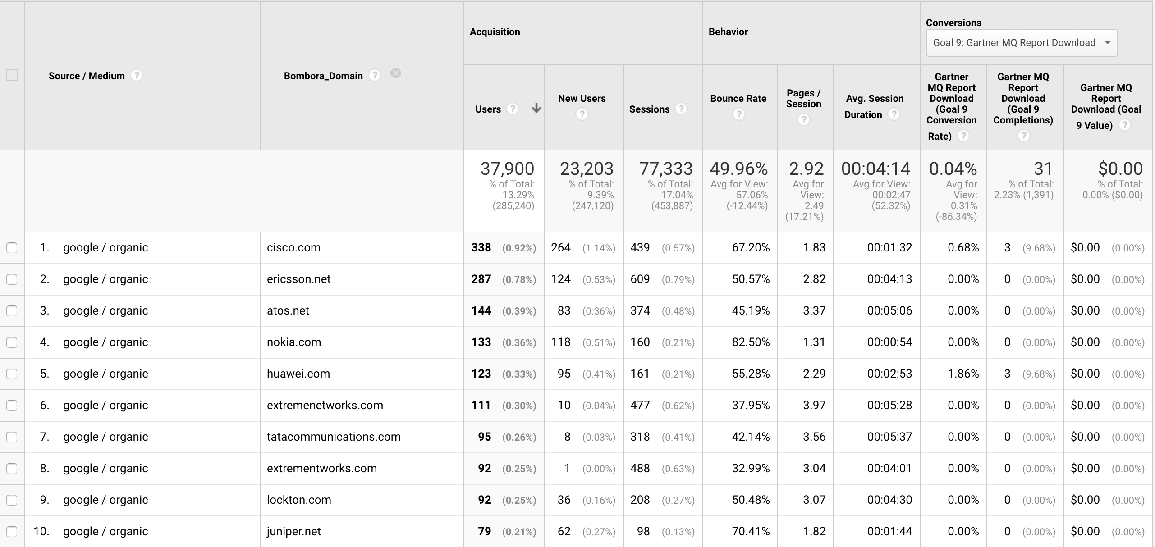
Bombora / GA Screenshots
GA view: Organic visitors by company domain

Slide 10
Bombora Visitor Insights Tag Uses
The VI tag helps build a more complete picture of your B2B website audience, enabling you to:
Optimize website content by identifying which pages/products your target users are focusing on
Identify new target accounts for your sales team to engage
Improve digital media campaigns by using the intent data to inform messaging and targeting
Understand & more accurately measure the impact of your account-based efforts
Enrich your reporting using Bombora-sourced data, including
Intent: topics & predictive categories
Firmographic: domain ,company size, revenue, industry
Demographic: job seniority, functional area, professional group, education level

Slide 11
LinkedIn

Slide 12
LinkedIn Page Growth
Organic growth process
Create a posting cadence for the company LinkedIn page, aiming for 3-5 posts a week using a mix of: company updates, press clippings, white papers, blog posts
This enables you to identify your business as an industry leader using relevant, timely content to capture new followers to the page
Request C-suite reshare at least 1 post/week
Company content should be shared on the CEO page but should not be utilized as a main avenue to grow the business account
This is a personal page used for his own LinkedIn clout, not the business
CEO strategies are contrary to the goal of transitioning a single person away from the face of Medrobotics
Create and run a member group related to medical robotics to create additional industry connections and lead opportunities

Slide 13
LinkedIn Lead Acquisition
Support larger business goals beyond page followers growth using paid strategies such as:
Build lead capture campaigns that drive users to landing pages or Lead Gen Forms with gated assets, webinars, videos
Utilize LinkedIn Matched Audiences to target company lists or email lists for lead acquisition
Utilize LinkedIn attribute options:
Interest: member groups, interests
Firmographic: company name, company size, industry
Demographic: job experience, functional area, education
Run InMail campaigns to target individuals directly
Run remarketing campaigns for inactive leads or upselling

