Slide 2
User Experience Design Efforts

Slide 3
Digital Style Guide
Modular Landing Page
Resource Center
Reconstructed Navigation
TCO Calculator
Single Asset Landing Page
Multi Asset Landing Page

Slide 4
Web Style Guide
In an effort to refresh ZeroNorth’s digital style, Convertiv created a web style guide to help further define a number of design components for the website. These components included
Enhanced color pallet with primary, secondary, and tertiary colors
Breakdown of the current web typeface and how they can be applied to different ‘heading’ types
Showcase of button and link stles
Update of iconographic language and functional elements (e.g., paginations) along with examples of graphic language
You can view the Style Guide here: https://convertiv.invisionapp.com/share/MKU6NBS2CWQ

Slide 5
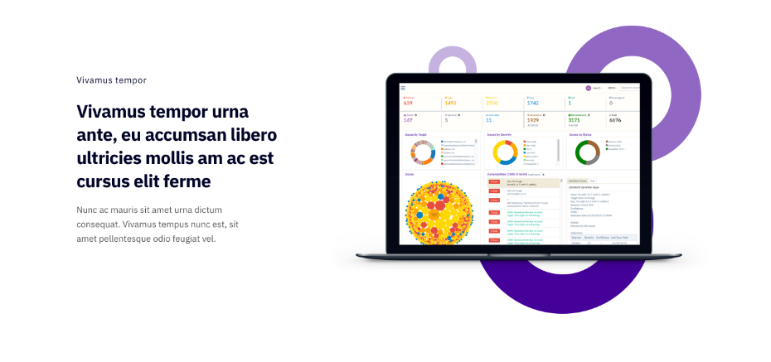
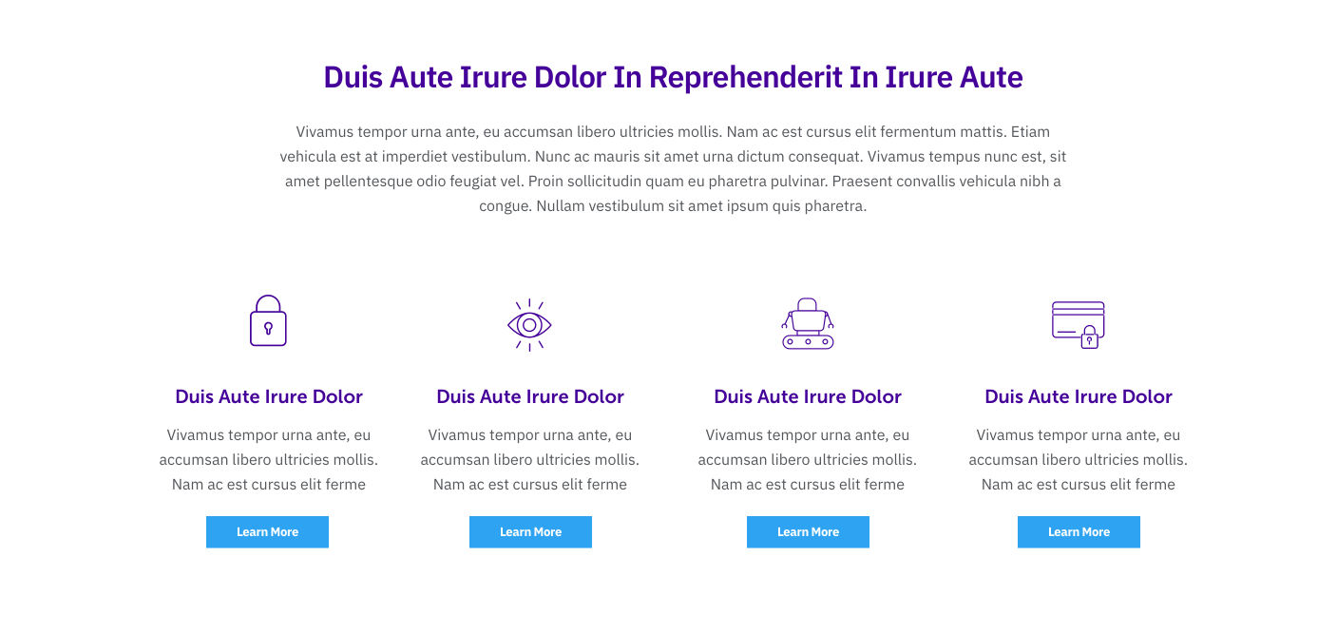
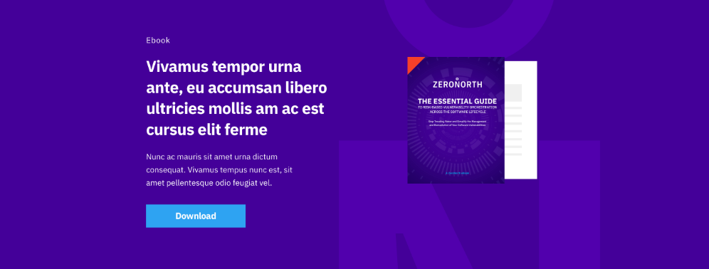
Modular Landing Page
Convertiv designed and implemented modular designs components based on enhanced ZeroNorth web styling. These multi-purpose modules were built into the Divi theme library with the ability to be used across the site.

Slide 6
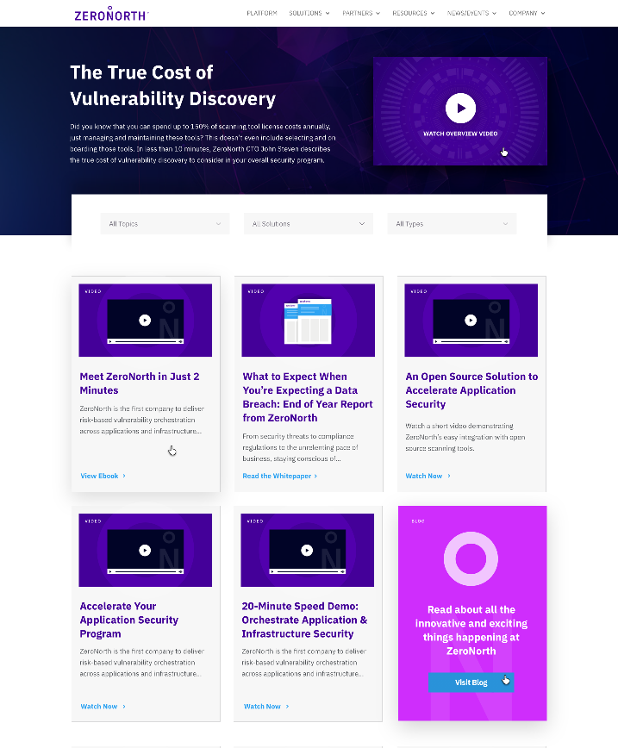
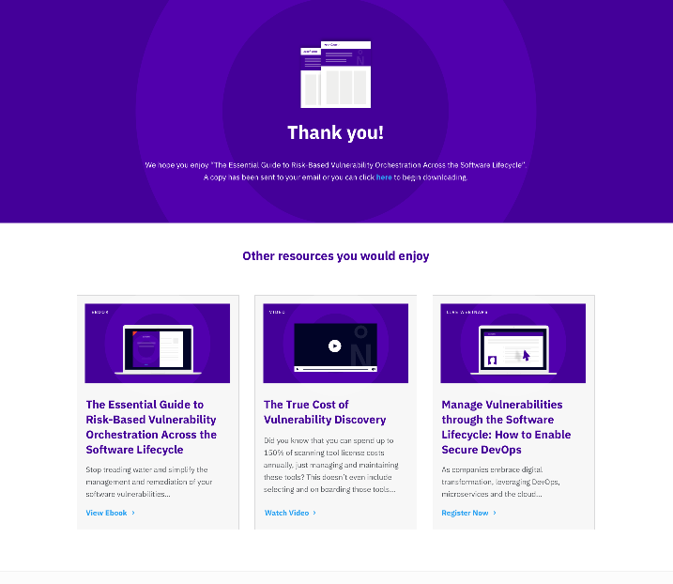
Resource Center Redesign
Redesigned the Resource Center archive page to serve the user a more streamlined experience for viewing and searching assets on the site. Taxonomies for Solutions, Topics and Asset Types were created to help users filter through to the right content.
Blog call-out ‘tiles’ were added to present users the option to view relevant blogs posts consistent with the topics they’re looking for.
New resource flows including gated, ungated and thank-you pages were also created to enhance the user experience.

Slide 7
Reconstructed Navigation
Convertiv conducted an audit of the main navigation and information architecture to decrease unnecessary clutter and create a design based on user intent wand finding information as easily as possible. This involved redesigning the entire navigation, removing the sub-navigation with an emphasis on making the main CTA more prominent, and bringing increased visibility to certain sections of the navigation.

Slide 8
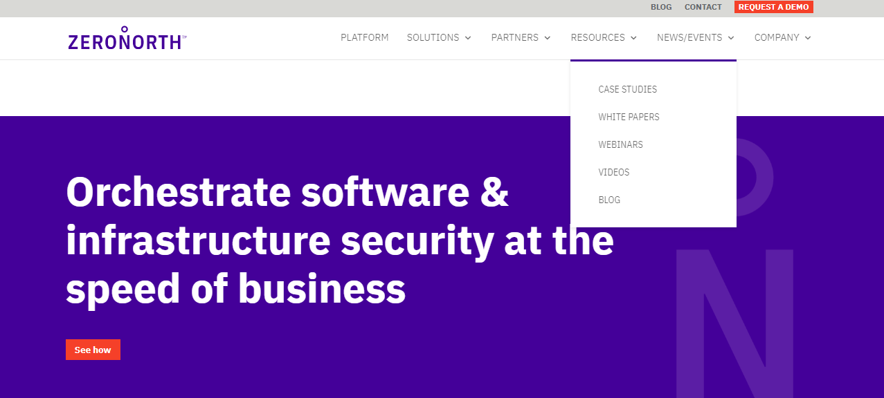
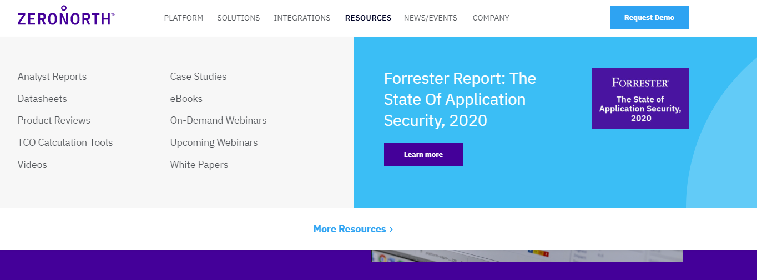
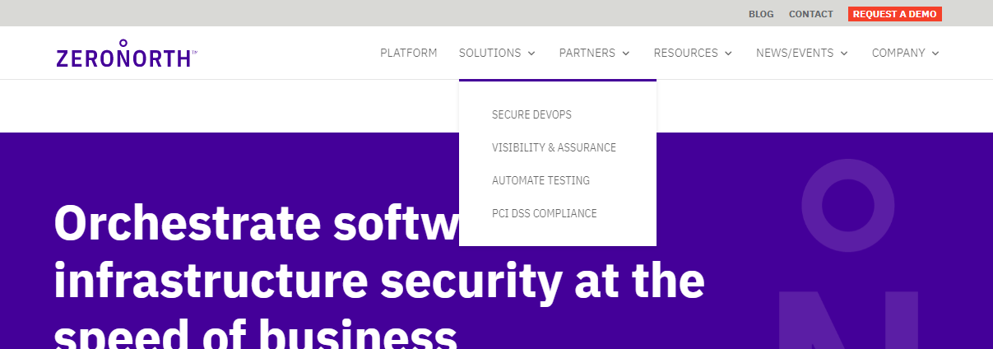
Before
After

Slide 9
TCO Calculator
Convertiv designed, developed and implemented a TCO calculator to help generate demand for ZeroNorth’s users across the site. This calculator focused on giving the users the information to determine the direct and indirect costs of effectively managing their security vulnerability management program and how they can leverage the ZeroNorth platform to decrease costs across the board. This was designed based on updated web styling using new elements as well as bringing in previous styles.

Slide 10
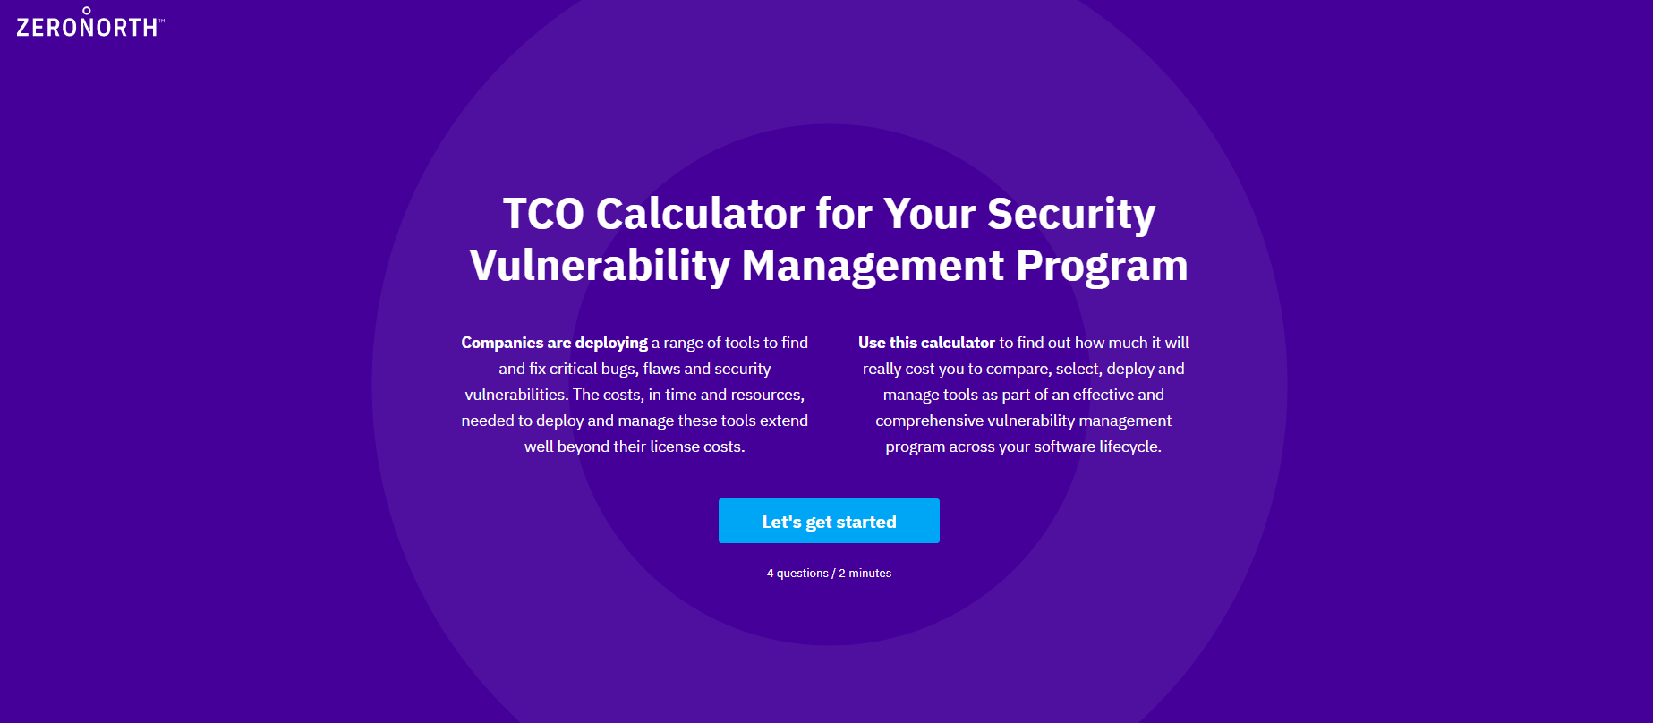
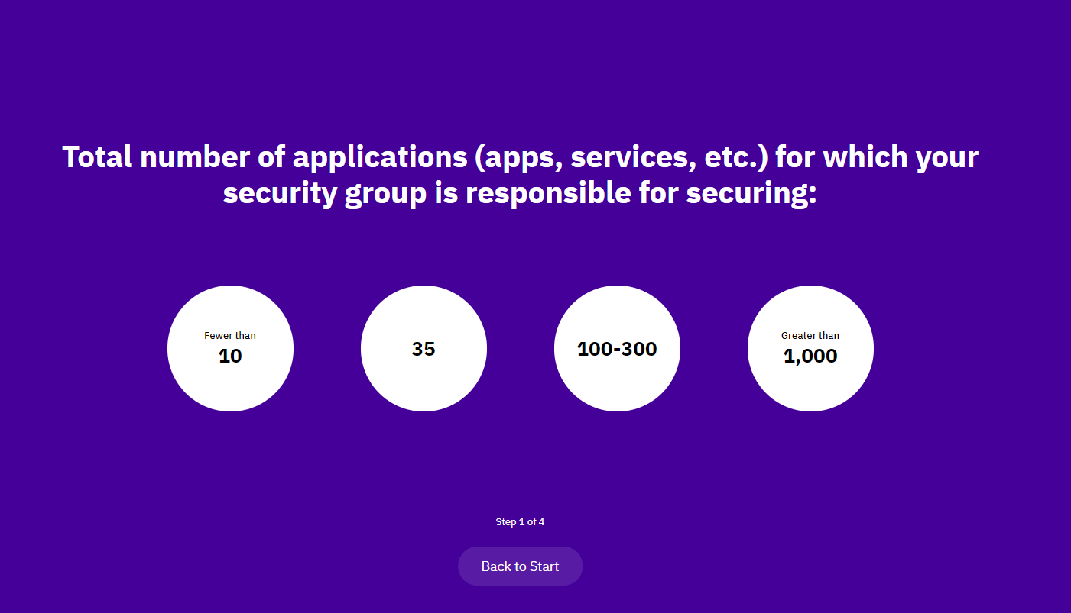
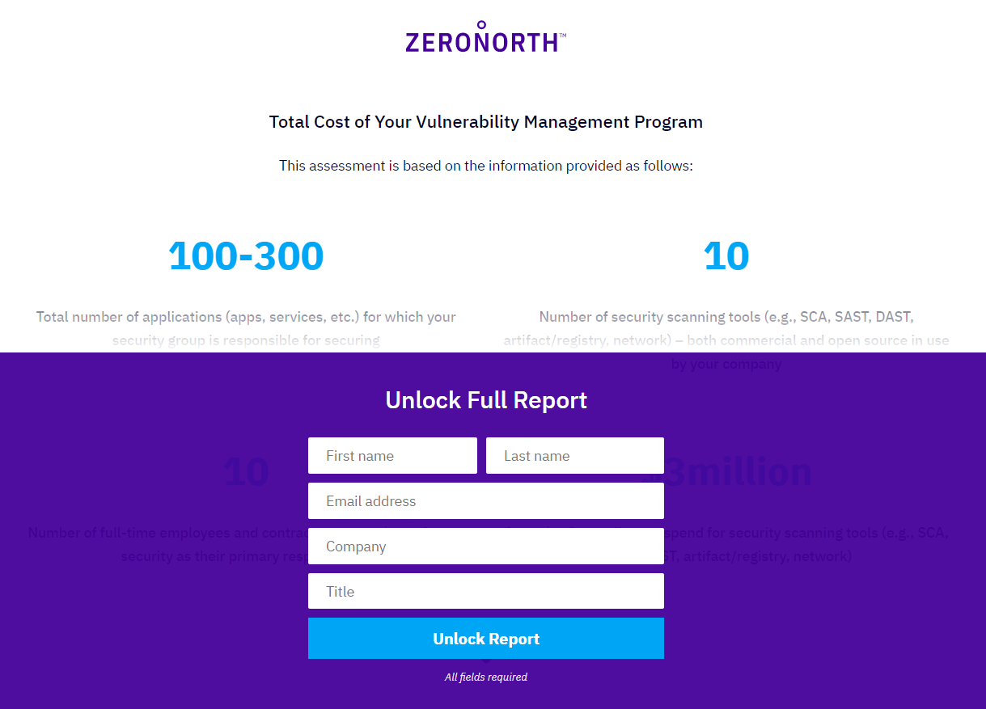
TCO Calculator

Slide 11
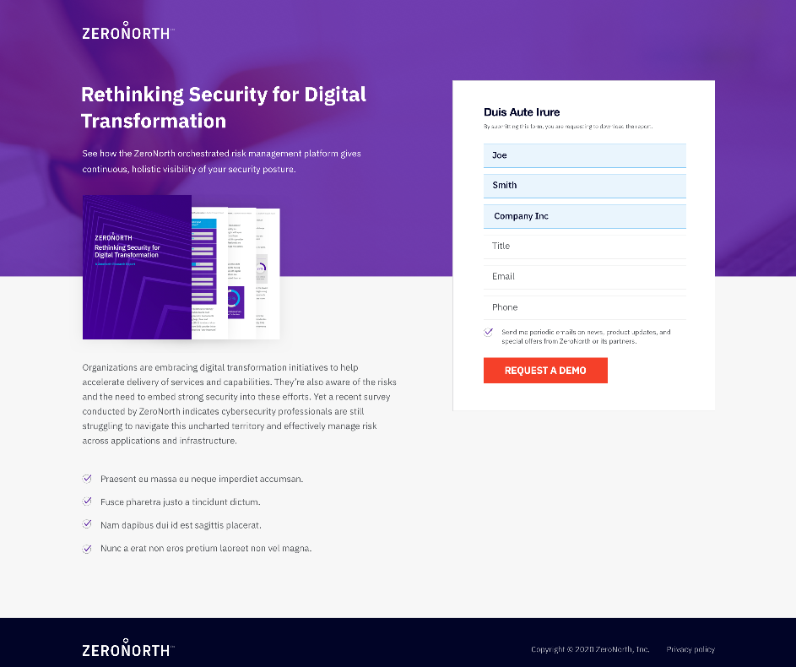
Single Asset Landing Page
To help with the ZeroNorth’s paid digital efforts, Convertiv designed a single asset lander to be used across multiple paid campaigns. Using conversion rate best practices, Convertiv created the single asset design to help deliver the optimal user experience used enhanced web styling. This design uses both elements from the resource center and modular landing page.

